Slide 1
Part - II
Cloud Security Threats and Attacks
Traffic Eavesdropping
Traffic Eavesdropping occurs when data being transferred to or within a cloud is passively intercepted by a malicious service agent for illegitimate information gathering purposes.
The aim of this attack is to directly compromise the confidentiality of the data and possibly the confidentiality of the relationship between the cloud consumer and cloud provider.

Slide 2
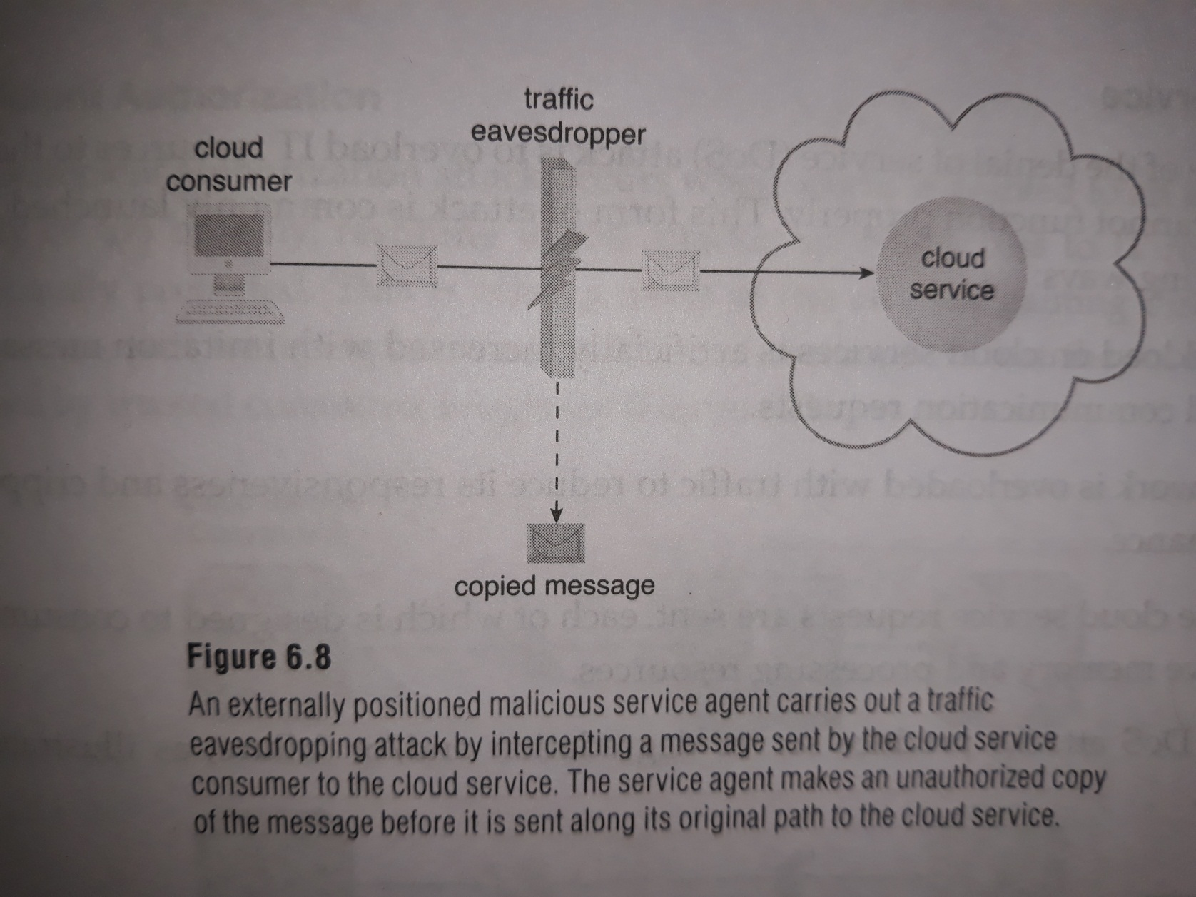
Traffic Eavesdropping

Slide 3
2) Malicious Intermediary
The malicious intermediary threat arises when messages are intercepted and altered by a .malicious service agent, thereby potentially compromising the message’s confidentiality and integrity.
It may also insert harmful data into the message before forwarding it to its destination.

Slide 4
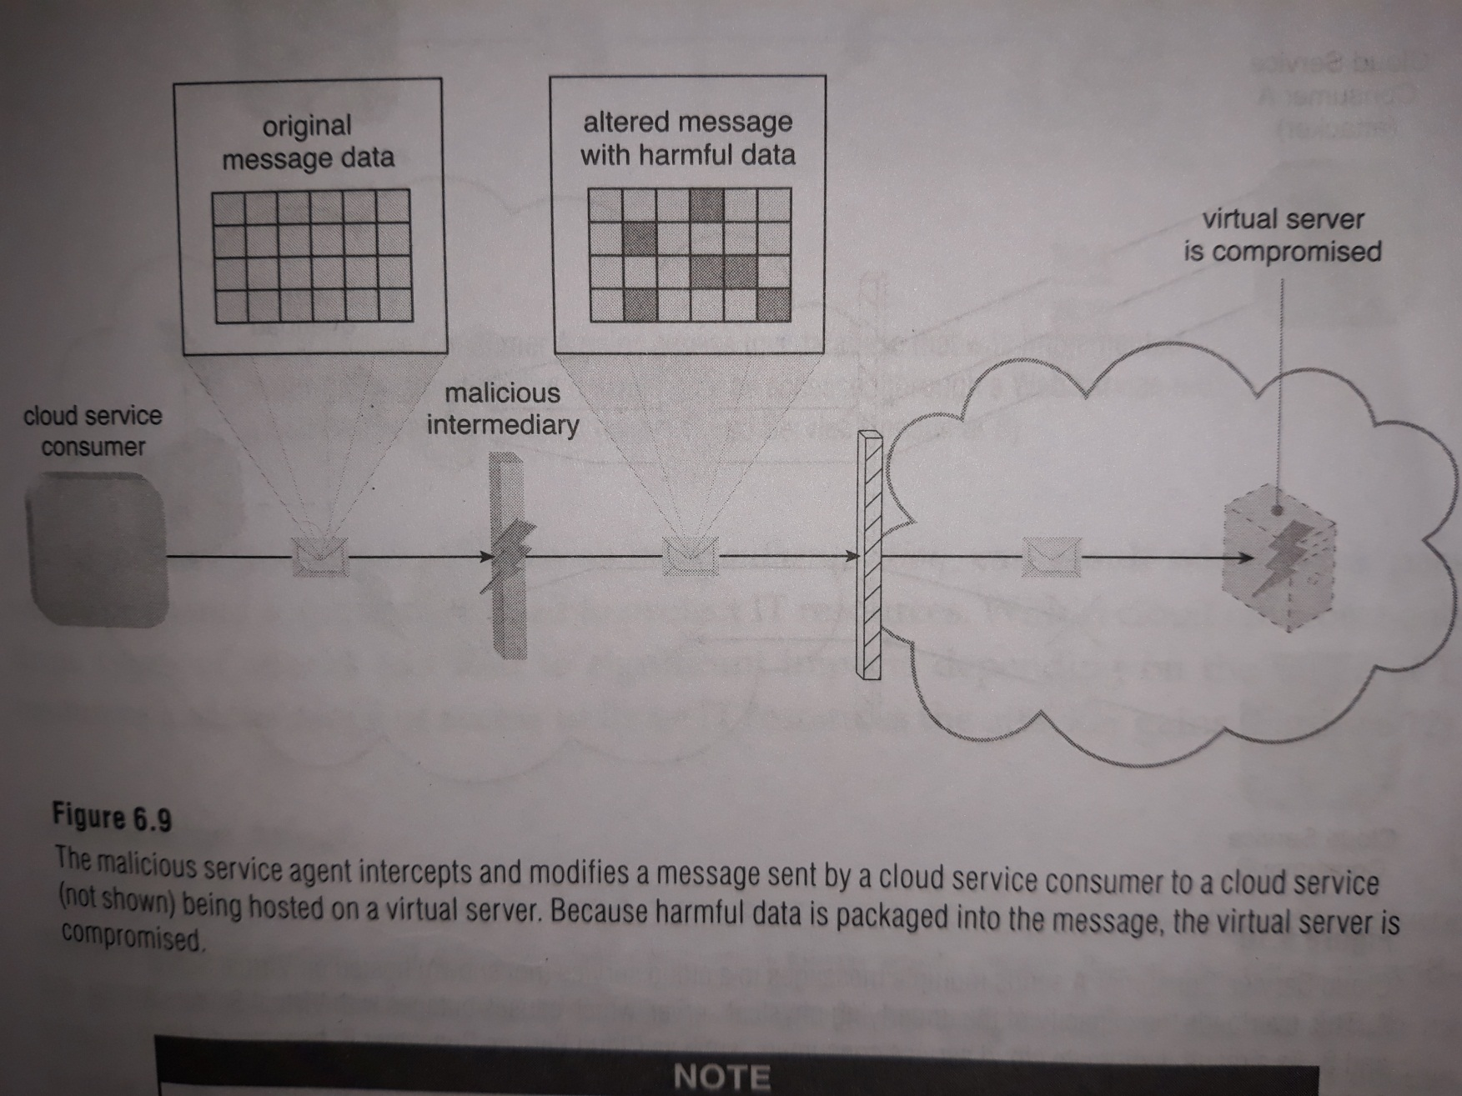
Malicious Intermediary

Slide 5
3) Denial of Service
The objectives of the denial of service (DoS) attack is to overload IT resources to the point where they cannot function properly.
This form of attack is commonly launched in one of the following ways:
The workload on cloud services is artificially increased with imitation messages or repeated communication request.
The network is overloaded with traffic to reduce its responsiveness and cripple its performance.
Multiple cloud service requests are sent, each of which is designed to consume excessive memory and processing resources.

Slide 6
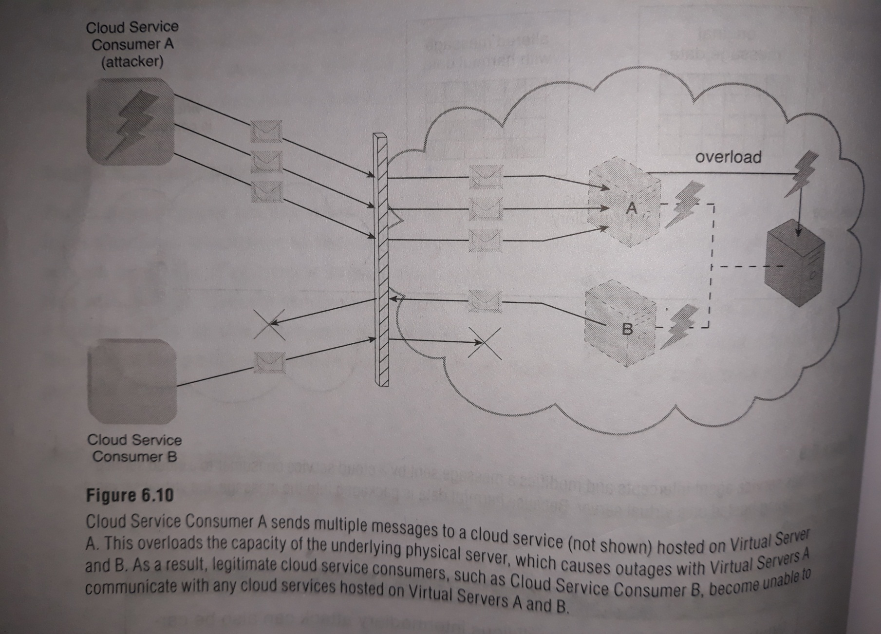
Denial of Service Attack

Slide 7
4) Insufficient Authorization
The insufficient attack occurs when access is granted to an attacker erroneously or too broadly, resulting in the attacker getting access to IT resources that are normally protected.
This is often a result of the attacker gaining direct access to It resources that were implemented under the assumption that they would only be accessed by trusted consumer program.

Slide 8
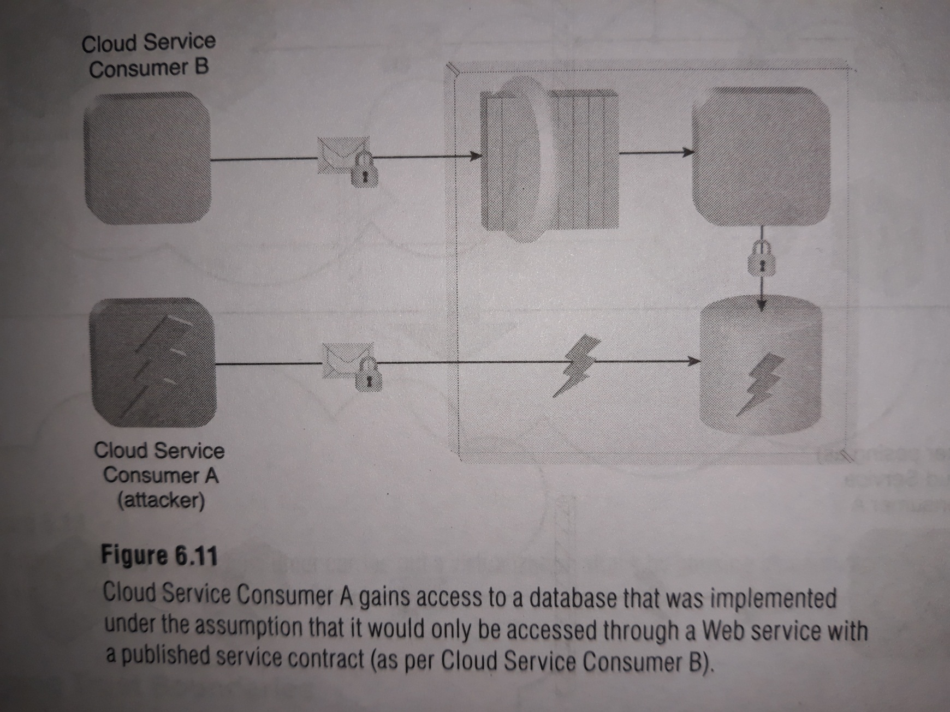
Insufficient Authorization

Slide 9
5) Virtualization Attack
Virtualization provides multiple cloud consumers with access to IT resources that share underlying hardware but are logically isolated from each other.
Cloud providers grant cloud consumers administrative access to virtualized IT resources, there is an inherent risk that cloud consumers could abuse this access to attack the underlying physical IT resources.

Slide 10
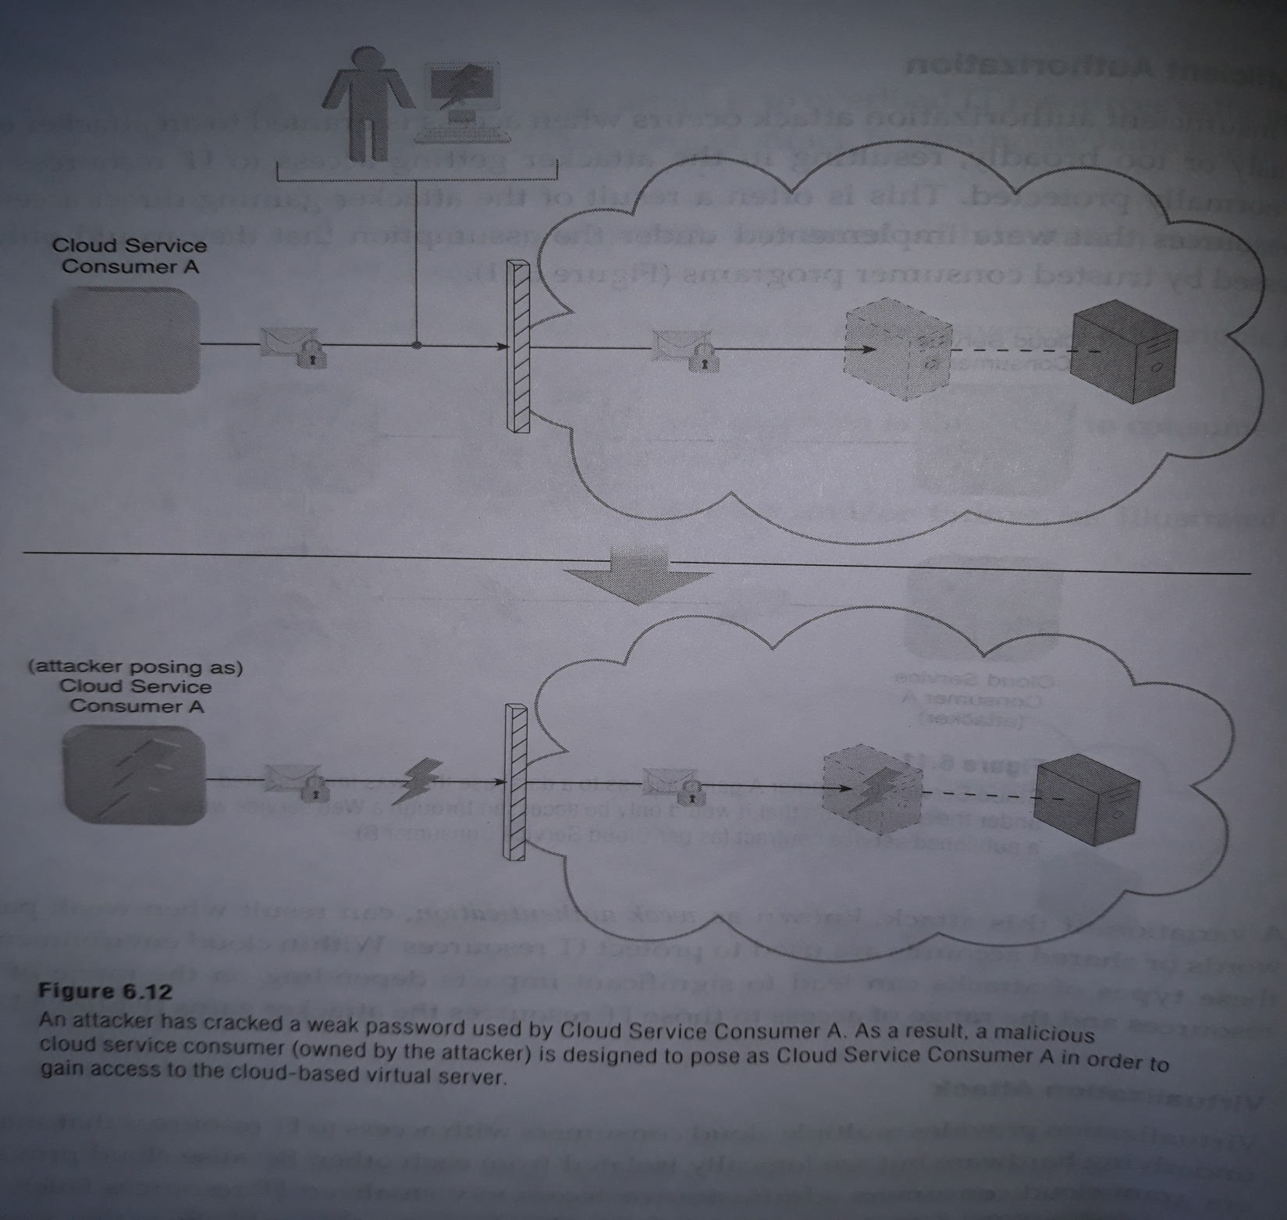

Slide 11
Overlapping Trust Boundaries
If physical IT resources within a cloud are shared by different cloud service consumers , these cloud service consumers have overlapping trust boundaries .
Malicious cloud service consumers can target shared IT resources with the intention of compromising cloud consumers or other IT resources that share the same trust boundary.

Slide 12
Additional Considerations
Flawed Implementations
The substandard design, implementation, or configuration of cloud service deployment can have undesirable consequences, beyond runtime exceptions and failures.
If the cloud provider’s software and/or hardware have inherent security flaws or operational weakness, attackers can exploit these vulnerabilities to impair the integrity, confidentiality and/or availability of cloud provider IT resources and cloud consumer IT resources hosted by the cloud provider.

Slide 13
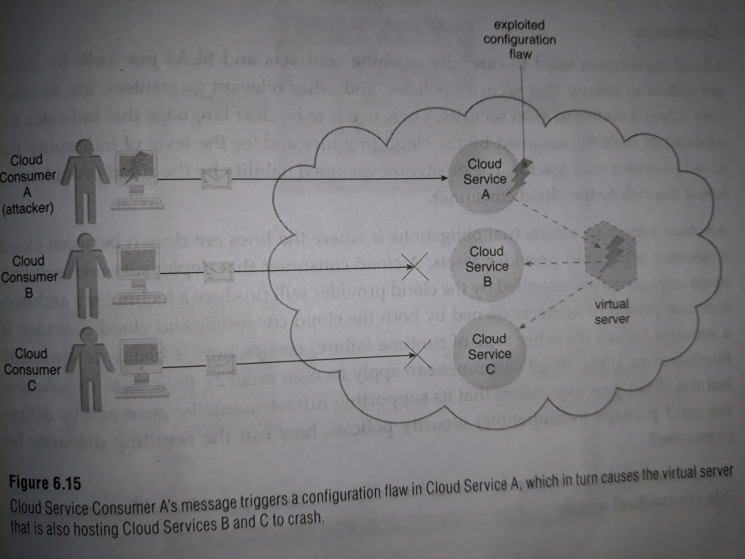

Slide 14
Security Policy Disparity
When a cloud consumer places IT resources with a public provider, it may need to accept that its traditional information security approach may not be identical or even similar to that of the cloud provider.
This incompatibility needs to be assessed to ensure that any data or other IT assets being relocated to a public cloud are adequately protected.
Contracts
Cloud consumers need to carefully examine contracts and SLAs put forth by cloud providers to ensure that security policies , and other relevant guarantees are satisfactory when it comes to asset security.

Slide 15
Risk Management
When accessing the potential impacts and challenges pertaining to cloud adoption, cloud consumers are encouraged to perform a formal risk assessment as part of a risk management strategy.
A cyclically executed process used to enhance strategic and tactical security, risk management is comprised of a set of coordinated activities for overseeing and controlling risks.

Slide 16
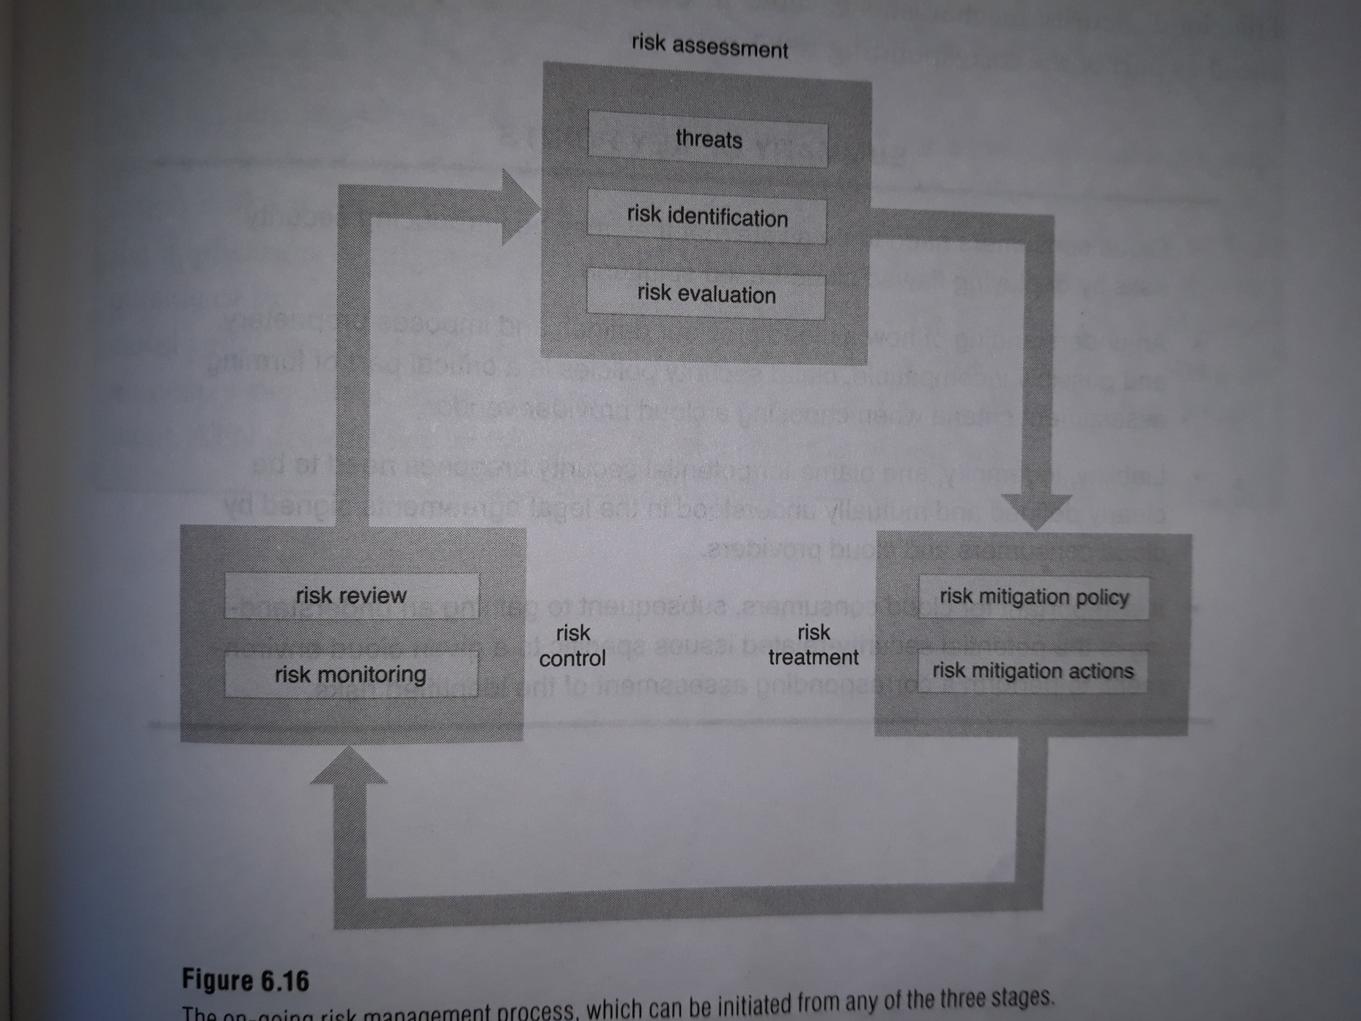

Slide 17

Risk
the possibility of loss or harm arising from performing an activity.
Two metrics that can be used to determine risk for an IT resource are:
the probability of a threat occurring to exploit vulnerabilities in the IT resource
the expectation of loss upon the IT resource being compromised

Slide 18


















Vulnerability
Threats
Risks
Measure the lack of security

Slide 19
Security Controls
are countermeasures used to prevent or respond to security threats and to reduce or avoid risk.
Preventive Controls(looking out unauthorized intruders)
Detective Controls ( Sounding Alarm)
Corrective Controls( Recovering)

Slide 20
Security Mechanisms
Countermeasures are typically described in terms of security mechanisms, which are components comprising a defensive framework that protects IT resources, information, and services.

Slide 21
Security Policies
A security policy establishes a set of security rules and regulations. Often, security policies will further define how these rules and regulations are implemented and enforced.

Slide 22


















Security Mechanisms
Security Controls
Security Policies
Support of improving security

Slide 23

Threat Agents
A threat agent is an entity that poses a threat because it is capable of carrying out an attack.
Cloud security threats can originate either internally or externally, from humans or software programs.

Slide 24
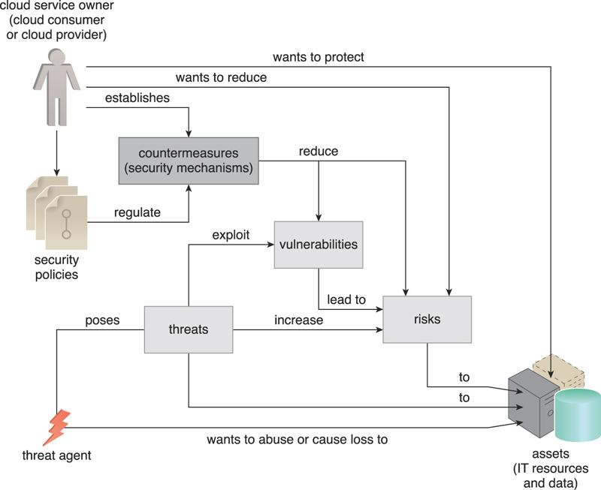
Threat agents
Figure 6.3 How security policies and security mechanisms are used to counter threats, vulnerabilities and risks caused by threat agents.

Slide 25

Anonymous Attacker
a non-trusted cloud service consumer without permissions in the cloud .
It typically exists as an external software program that launches network-level attacks through public networks.

Slide 26

Malicious Service Agent
A malicious service agent is able to intercept and forward the network traffic that flows within a cloud.
It typically exists as a service agent (or a program pretending to be a service agent) with compromised or malicious logic.
It may also exist as an external program able to remotely intercept and potentially corrupt message contents.

